Slide 1
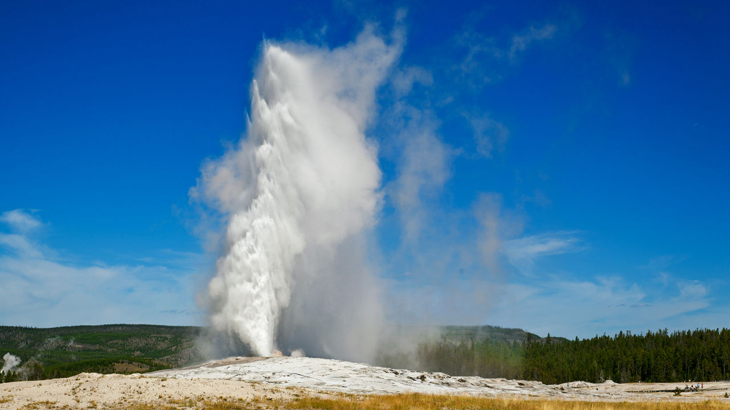
Old Faithful Geyser
Timing of Eruptions
Alberta “Albi” Kovatcheva

Slide 2
Background
Located in Yellowstone National Park, Wyoming.
Old Faithful was discovered in 1870 during the Washburn Expedition.
Yellowstone became the world’s first national park in 1872.
Old Faithful geyser was named for its frequent and somewhat predictable eruptions.
Old Faithful has erupted more than 1 million times since 1872 and has erupted every 44 minutes to two hours since 2000.

Slide 3
Scenario
The “faithful” dataset, which has the length in minutes of 272 eruptions of the Old Faithful geyser as well as the waiting time in minutes to the next eruption.
The eruption times for Old Faithful are clustered into two different groups. One group is short eruptions, and the other group is long eruptions. Short eruptions last three minutes or less, while long eruptions last more than three minutes.

Slide 4
Tasks
1. How many elements are in the vector short?
2. How many elements are in the vector long?
3. What is the mean eruption time of the short eruptions?
4. What is the mean eruption time of the long eruptions?
5. What is the standard deviation of the short eruption times?
6. What is the standard deviation of the long eruption times?

Slide 5
Summary
1. There are 97 elements in the vector “short”.
2. There are 175 elements are in the vector “long”.
3. The mean eruption time of the short eruptions is 2.038134 minutes.
4. The mean eruption time of the long eruptions is 4.291303 minutes.
5. The standard deviation of the short eruption times is 0.2668655 minutes.
6. The standard deviation of the long eruption times is 0.4108516 minutes.

Slide 6
Analysis and Conclusion
The eruption times range from approximately 1.6 to 5.1 minutes.
The mean eruption time is 3.488 minutes, and the median is 4 minutes.
This data is consistent with observed eruption times of 1 1/2 to 5 minutes.

